Slide 1
Invest in/For You

Slide 2
Puzzle
You bought a stock for ₹100 per share.
It rises 10% per day for 30 days.
On the 31st day, it crashes 90% in one day.

Slide 3
Puzzle Answer
A=P(1+r)n
A = Final amount
P = Initial price (₹100)
r = Growth rate per day (10% or 0.1)
n = Number of days (30)
Profit: A=1,745×0.10 =₹174.5
Loss: Loss=1,745×0.90 =₹1,570.5 total = 1745-1570 = 174.5

Slide 4
Importance of Insurance
Life is unpredictable
Medical emergencies can drain savings and push families into debt.
Medical inflation is 10-15% per year—treatment costs will only rise. A ₹5 lakh health cover today may not be enough in 10 years—insurance helps keep up with inflation.
Protects savings from unexpected medical emergencies.
Some policies offer cashless hospitalization, reducing immediate financial stress.

Slide 5
Term Insurance
Pays a lump sum to your family if you pass away. Ensures financial stability for dependents (spouse, children, parents).Helps cover loans, education costs, and daily expenses in your absence.
Premiums paid for health insurance qualify for tax deductions under Section 80D (India).

Slide 6
Few strategies while opting Insurance
Assess Your Needs – Evaluate your medical history, family needs, and expected healthcare expenses.
Check the Network – Ensure your preferred doctors, hospitals, and specialists are included in the insurer's network.
Review Claim Settlement Ratio – Choose an insurer with a high claim settlement ratio for hassle-free claim approval.
Look for No-Claim Bonus – Some insurers offer a bonus or discount for every claim-free year, reducing future premiums.
Check Waiting Periods – Understand the waiting period for pre-existing diseases, maternity, and specific treatments.
Read Exclusions Carefully – Be aware of what is not covered, such as specific diseases, alternative treatments, or lifestyle-related conditions.
Compare Online & Read Reviews – Use online tools to compare plans and read customer feedback to gauge service quality.
Check Amount

Slide 7


Slide 8
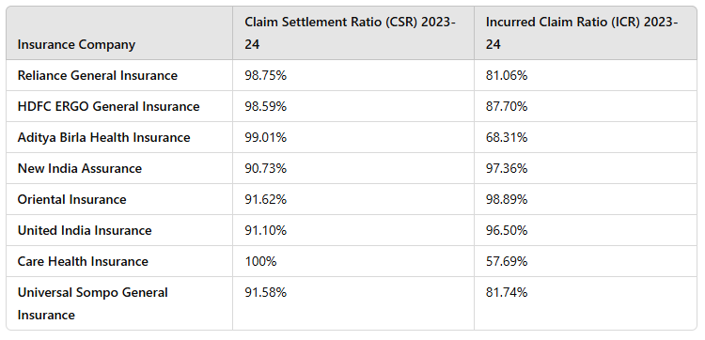
FY203-24

Slide 9
Popular Investment Options
Mutual Funds:
Stock Market:
FD

